Slide 1
Social Media & Public Health

Slide 2
What Is Social Media

Slide 3
History of Media

Slide 5
Why Do We Use Social Media

Slide 6
Social Media Tools

Slide 7
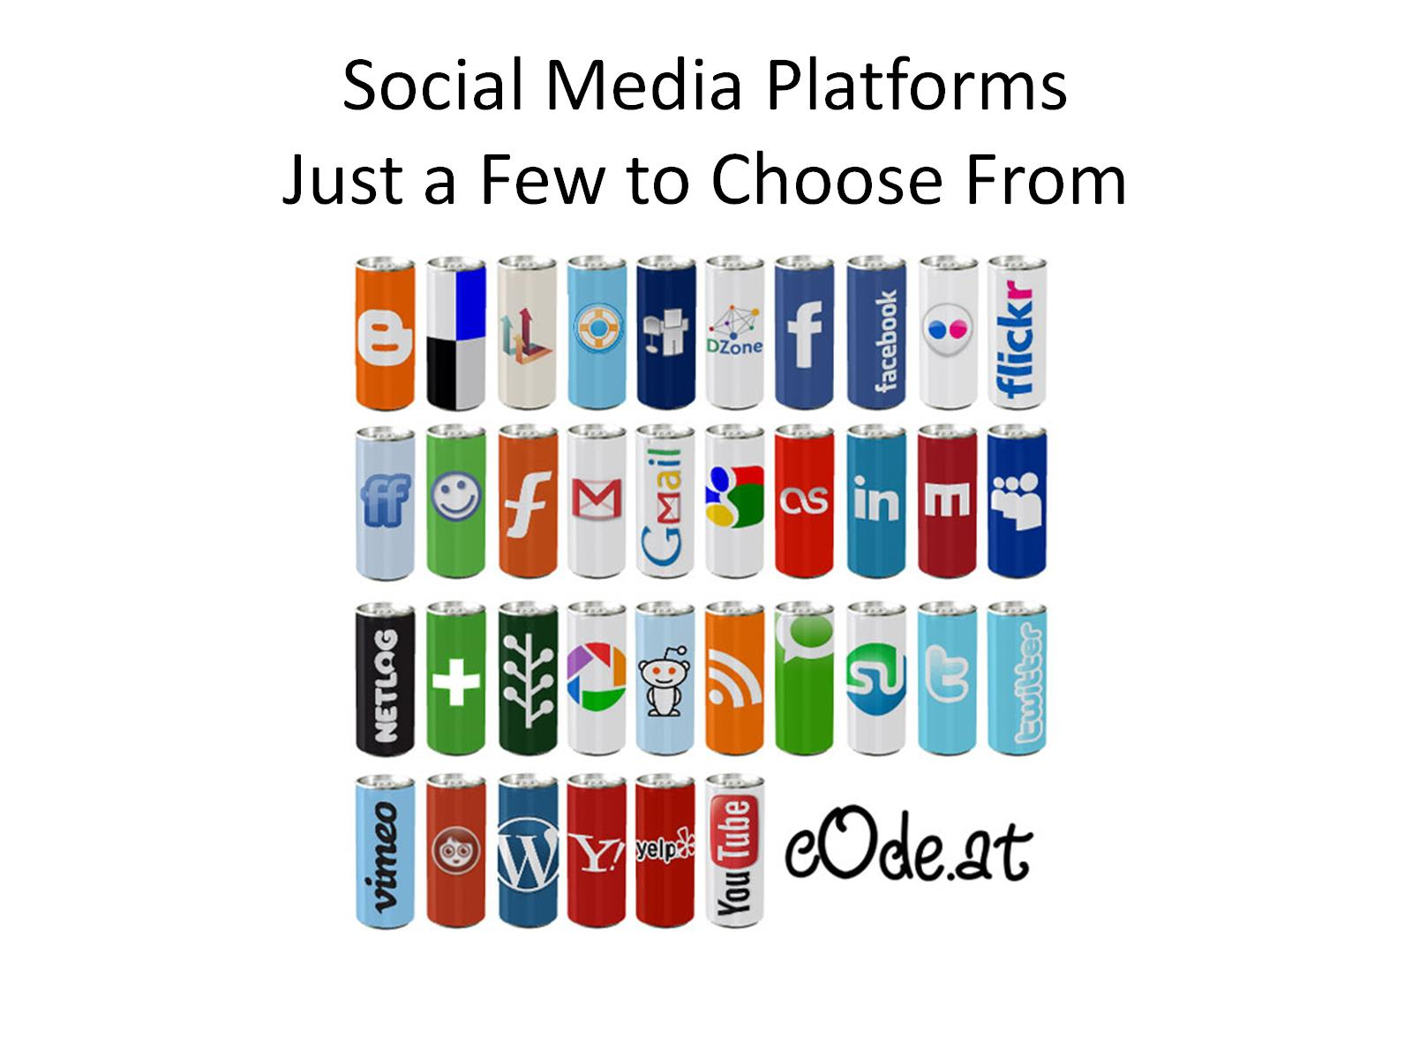
Social Media Platforms Just a Few to Choose From

Slide 8
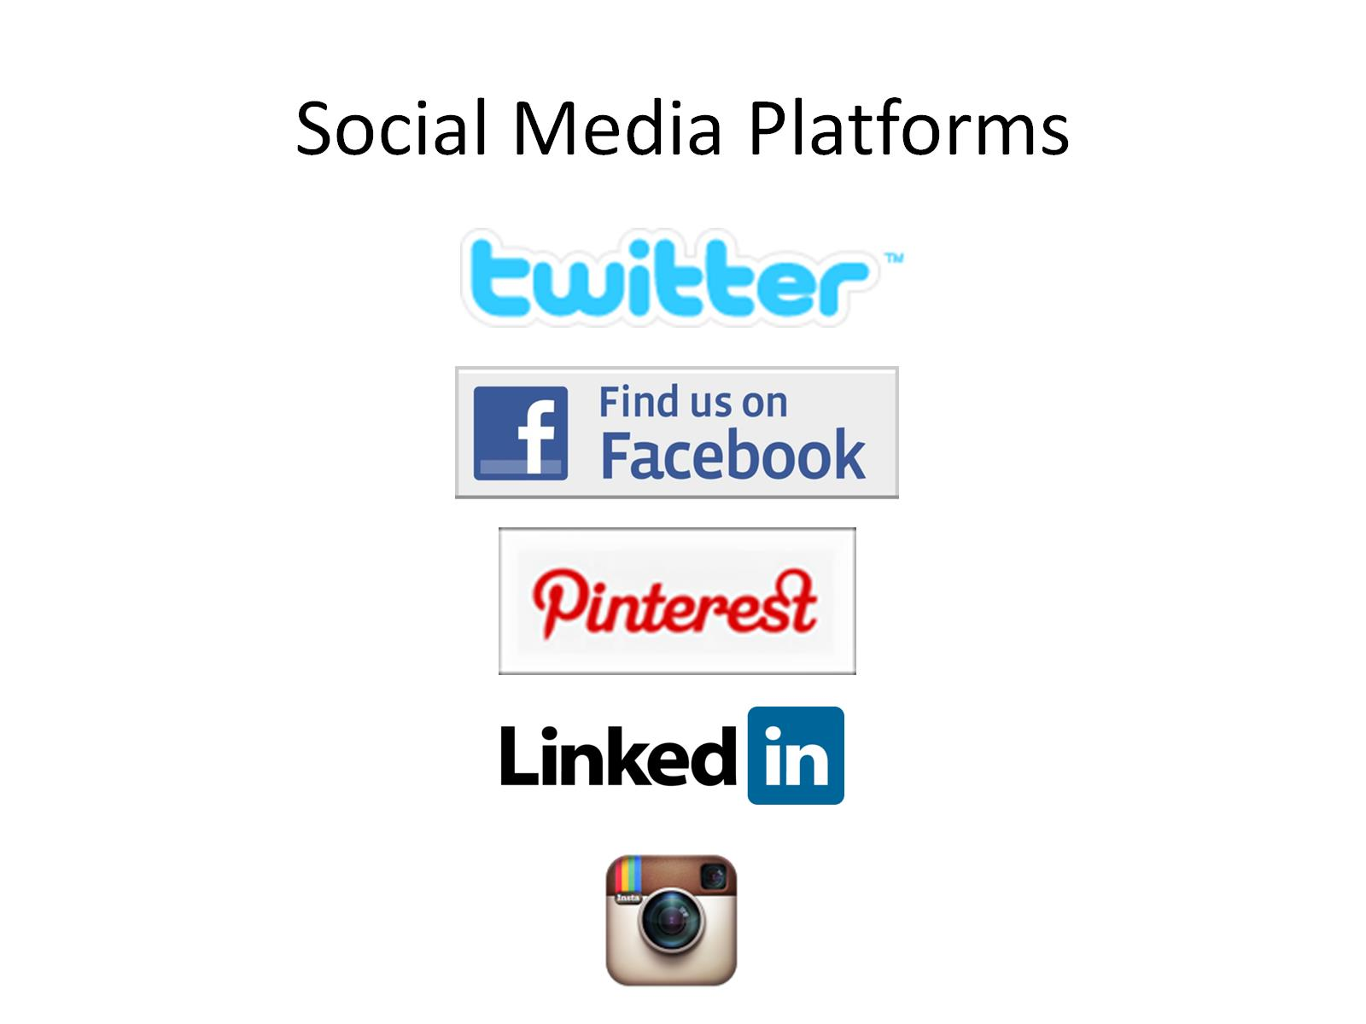
Social Media Platforms

Slide 13
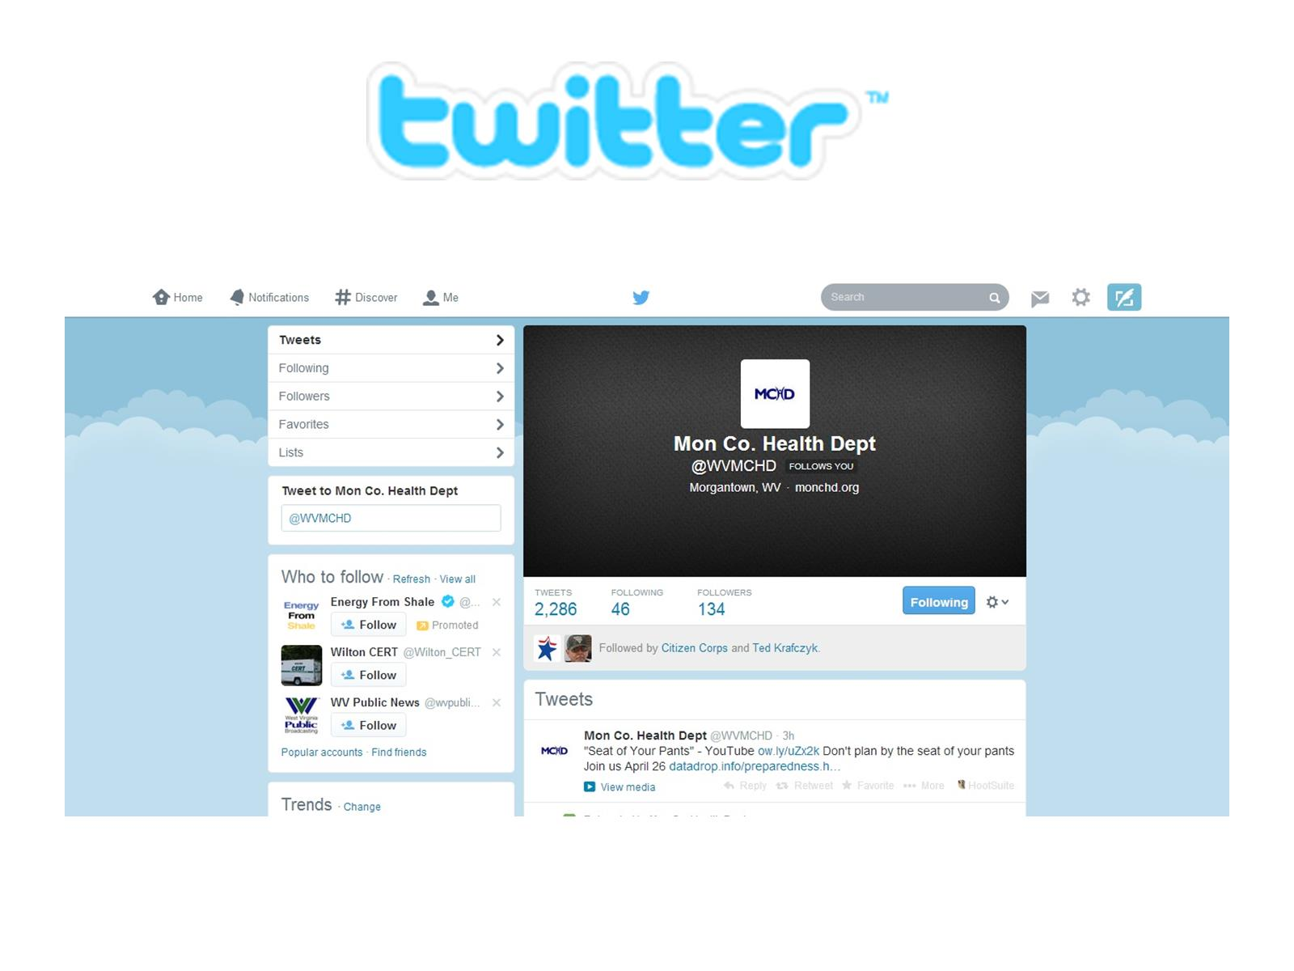

Slide 14
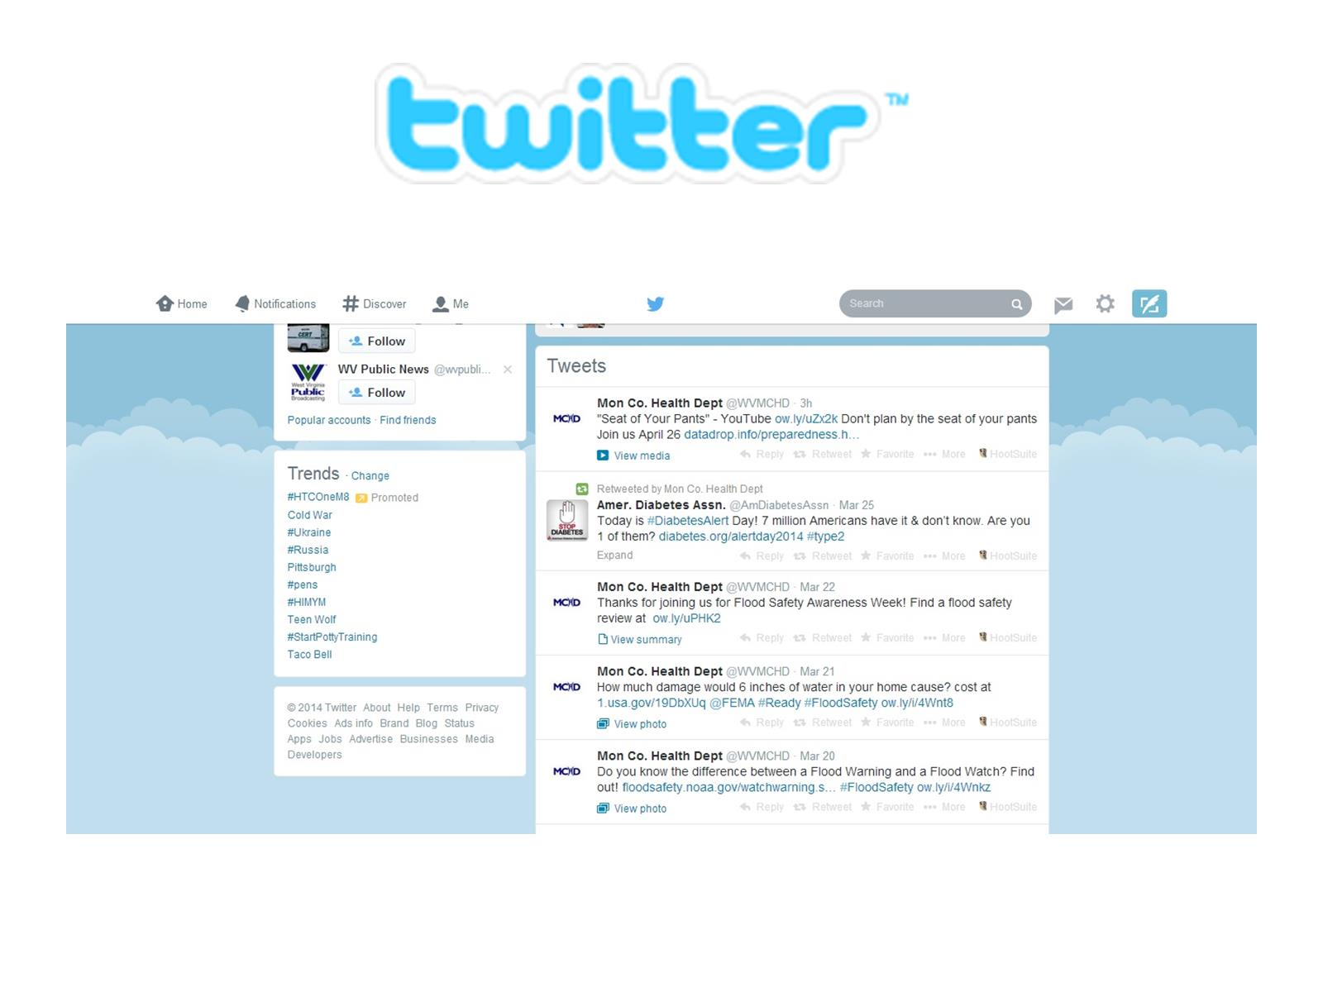

Slide 15
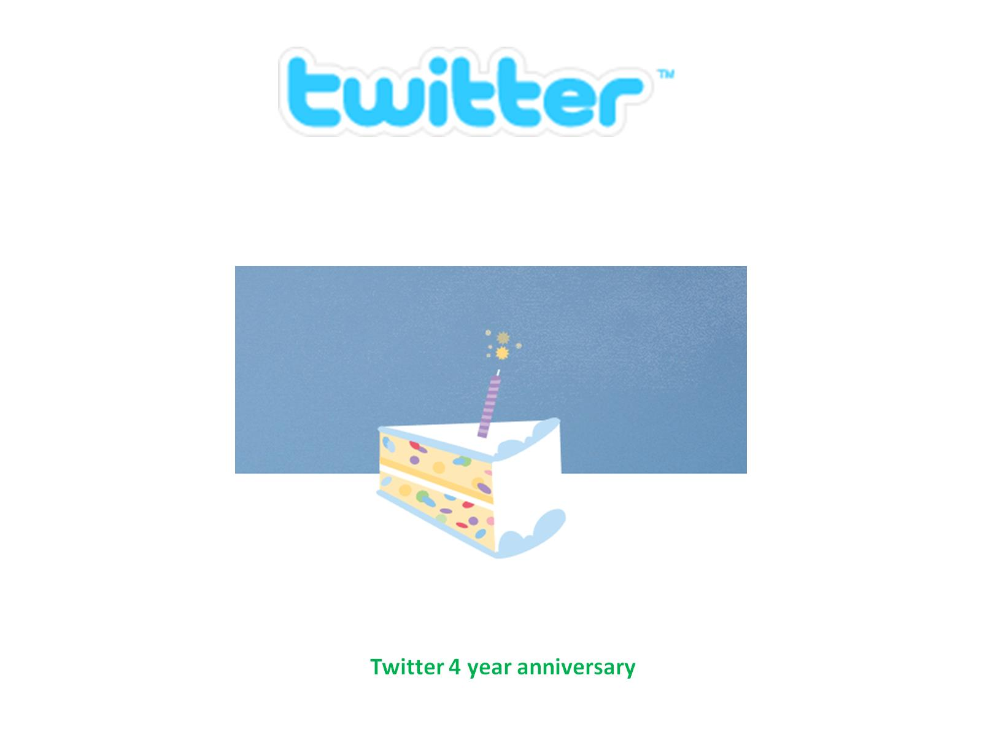

Slide 19
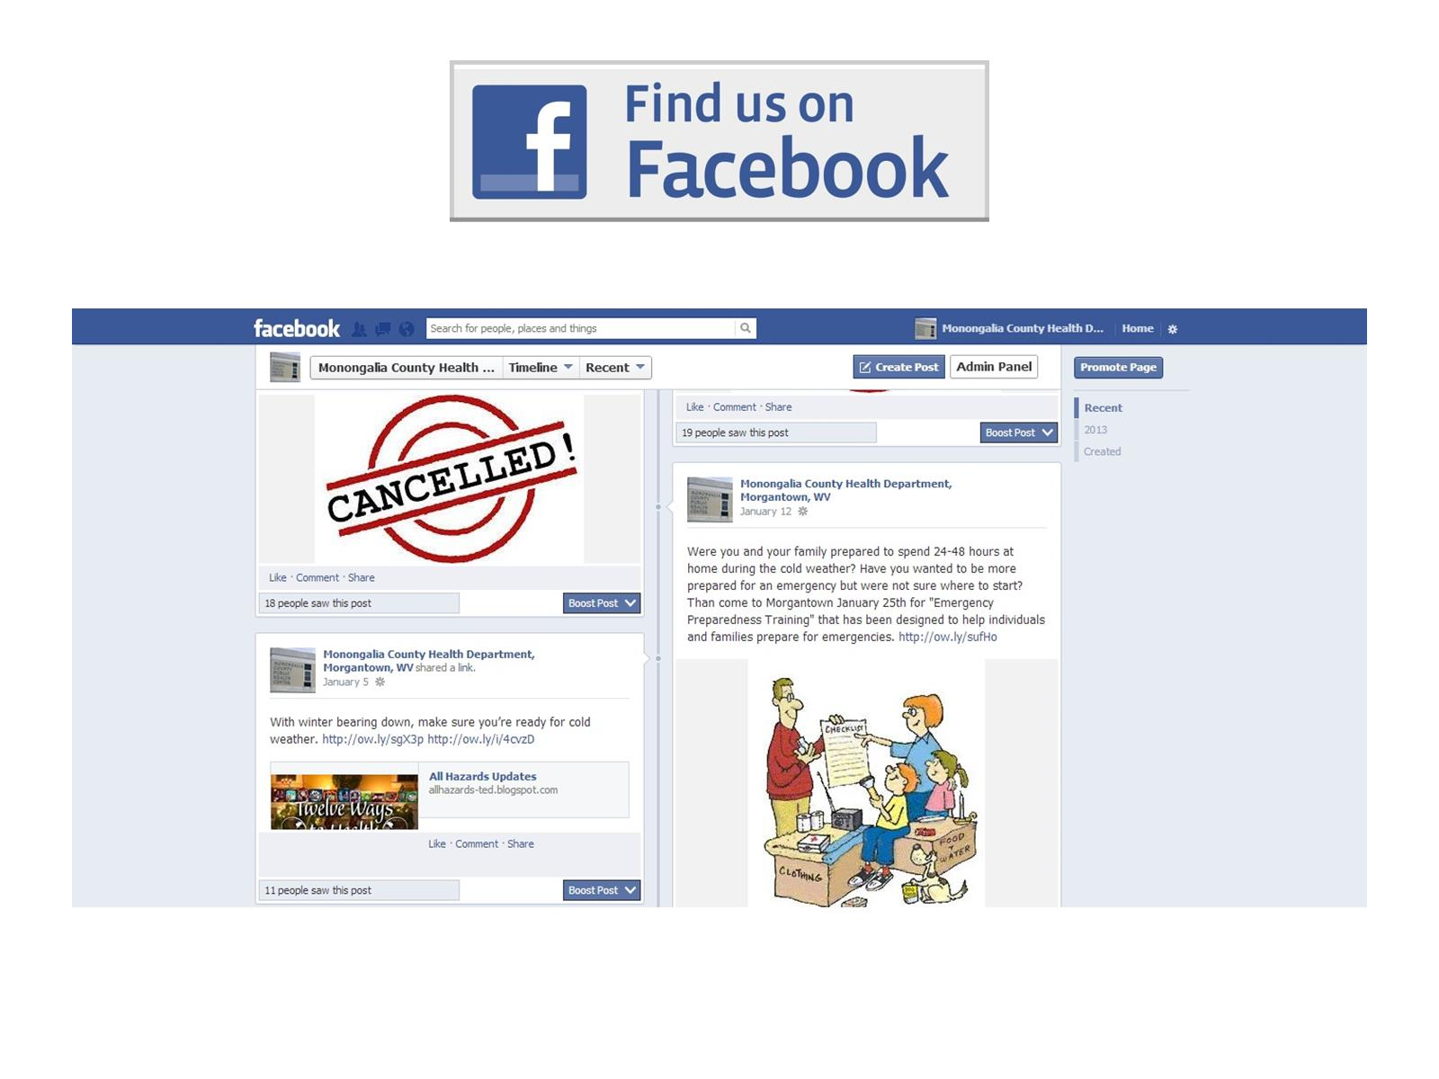

Slide 24
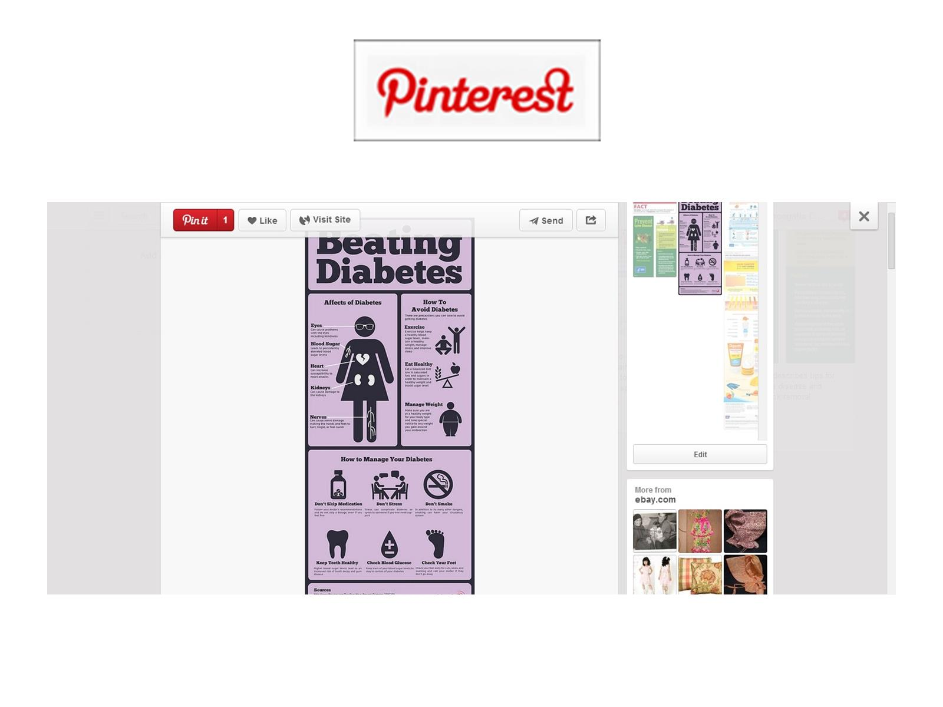

Slide 27
Sign up to use Social Media

Slide 28
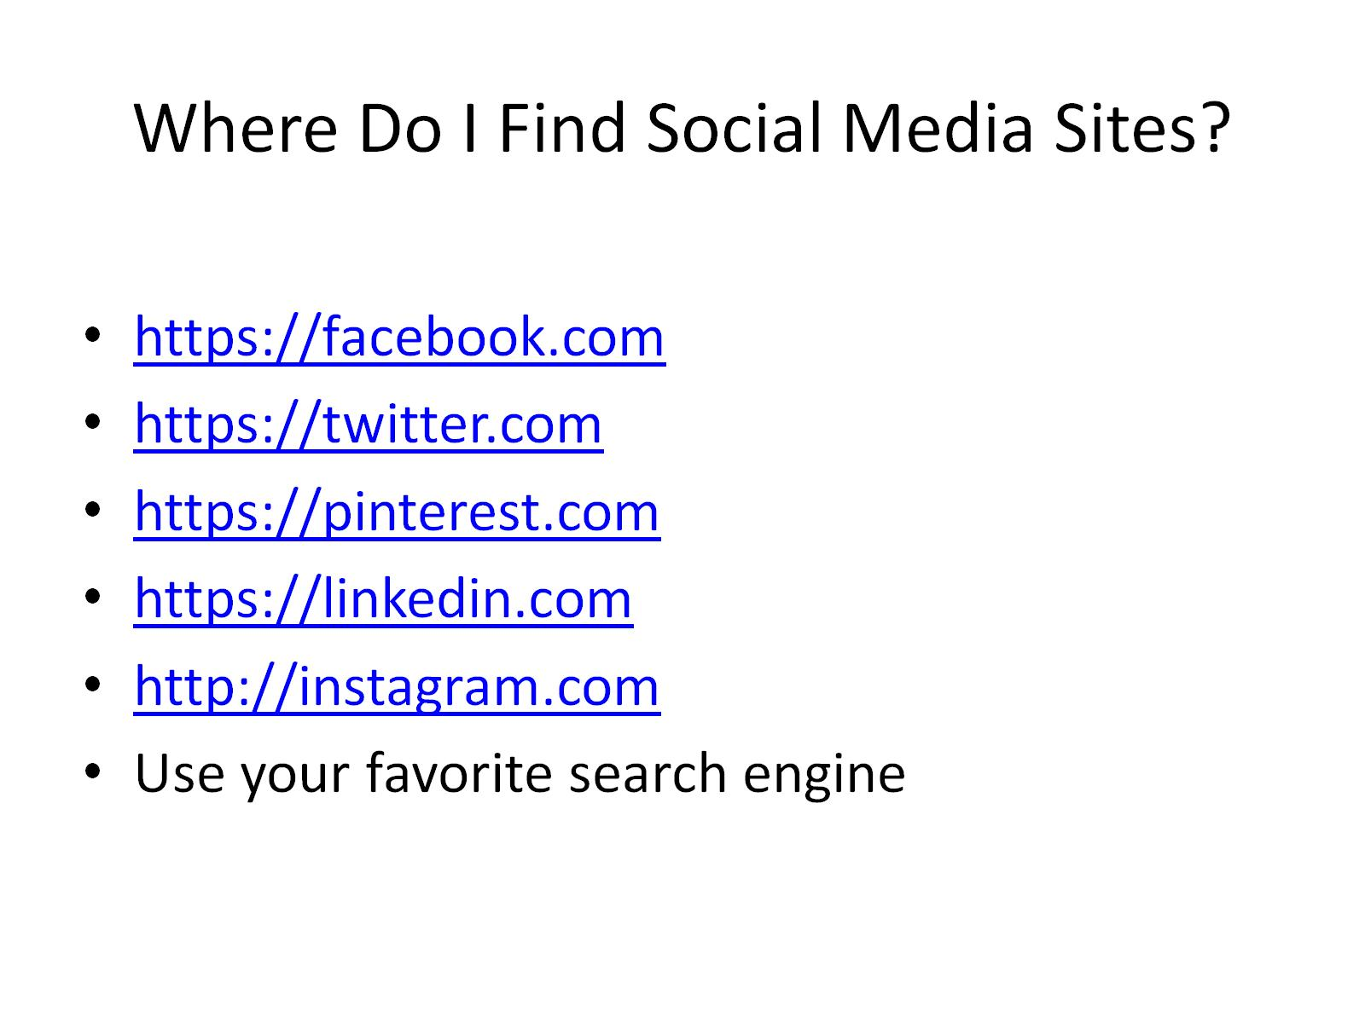
Where Do I Find Social Media Sites?

Slide 29
Public Health Social Media

Slide 30
Disaster Management Cycle

Slide 31
Uses in Mitigation & Preparedness

Slide 32
Uses in Response

Slide 33
Uses in Recovery

Slide 34
Which Social Media Works for Me

Slide 35
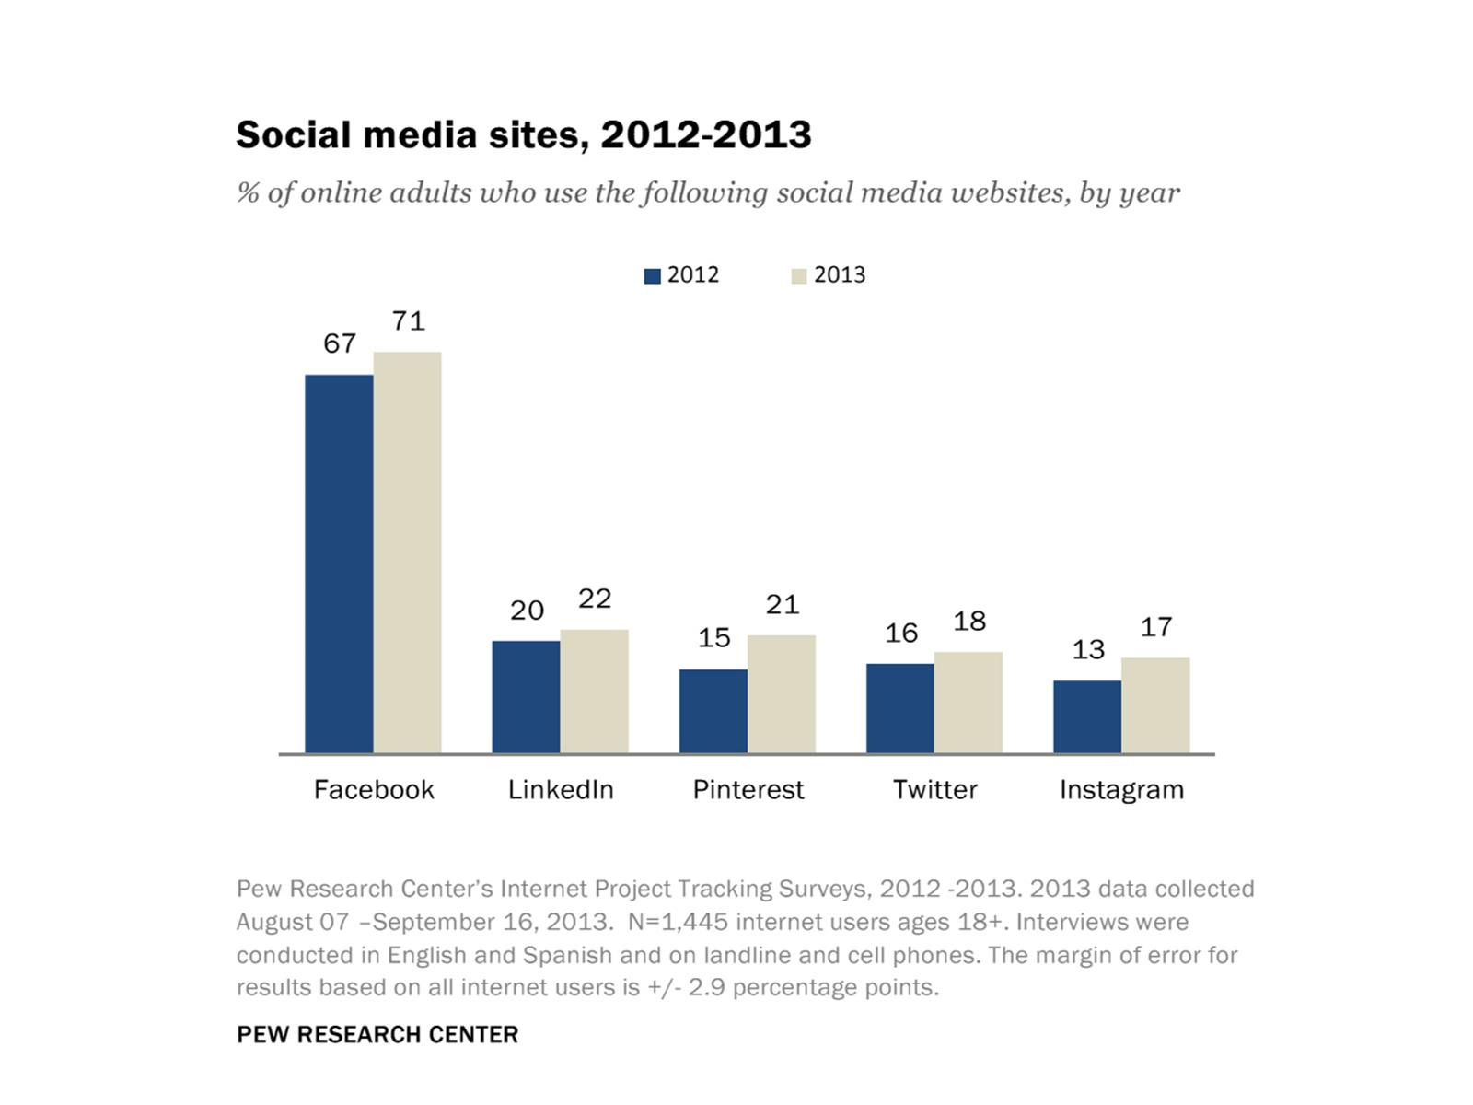

Slide 36
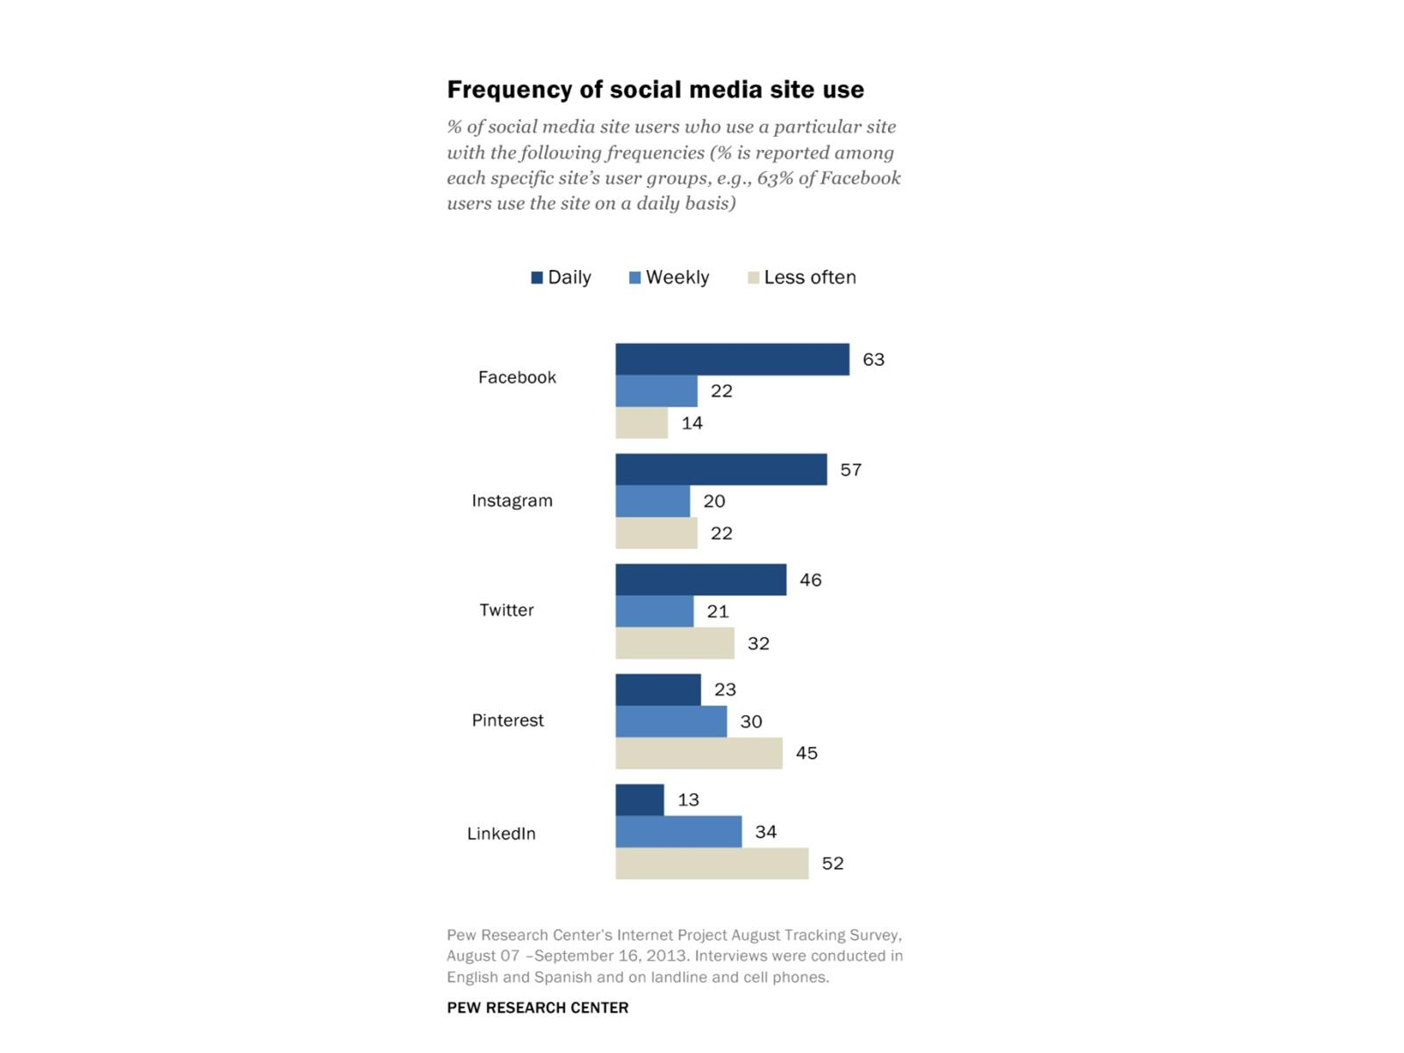

Slide 37
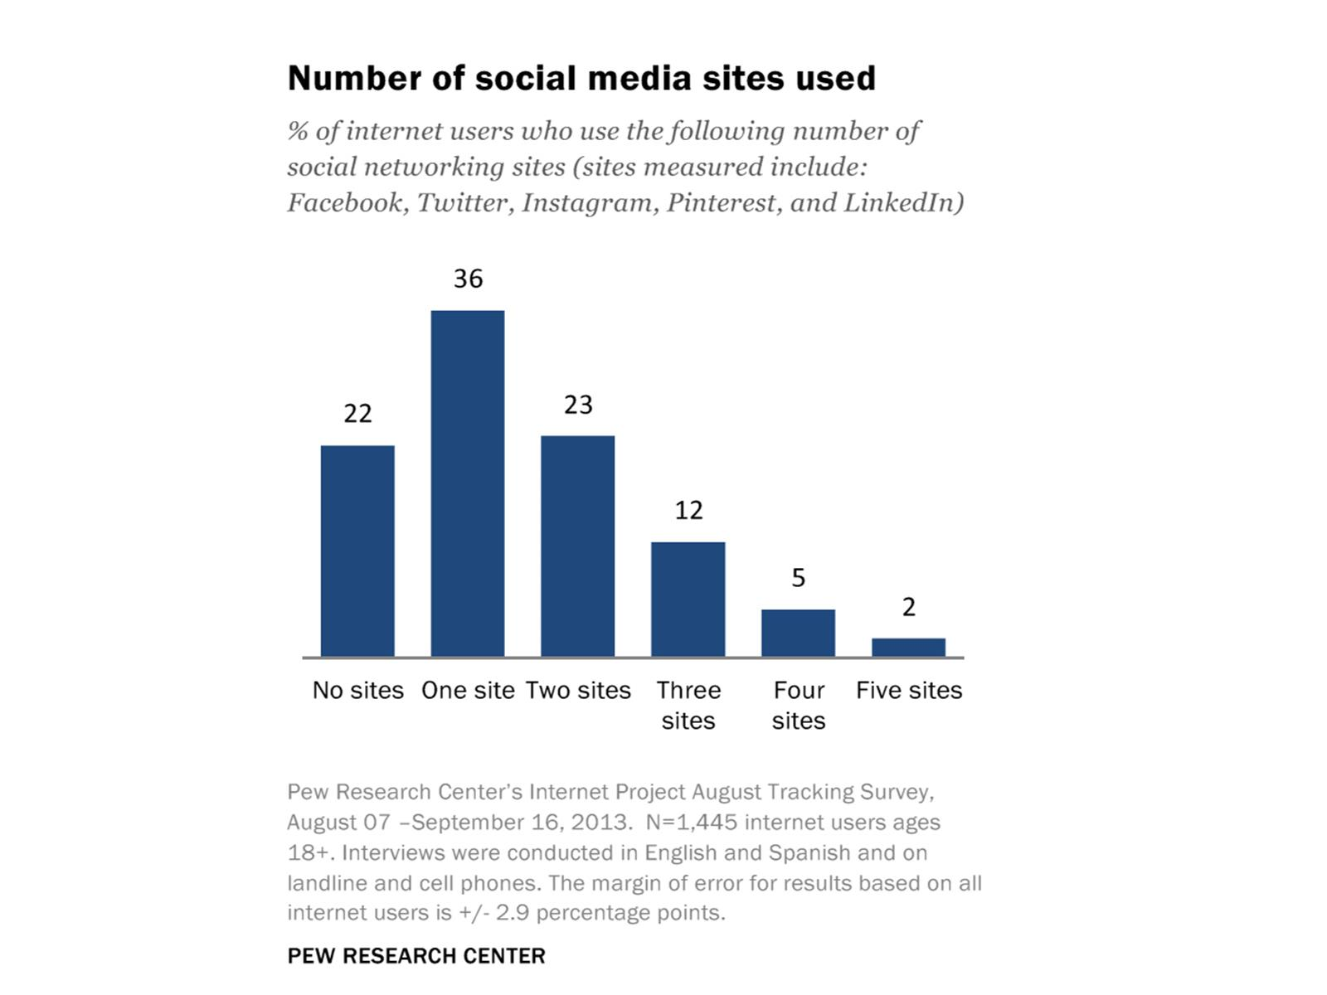

Slide 38
Which Social Media Works for Me

Slide 39
MCHD Main Media Platforms

Slide 40
Supporting Media Tools

Slide 41
Website

Slide 42
Website

Slide 43
Website

Slide 44
Website

Slide 46
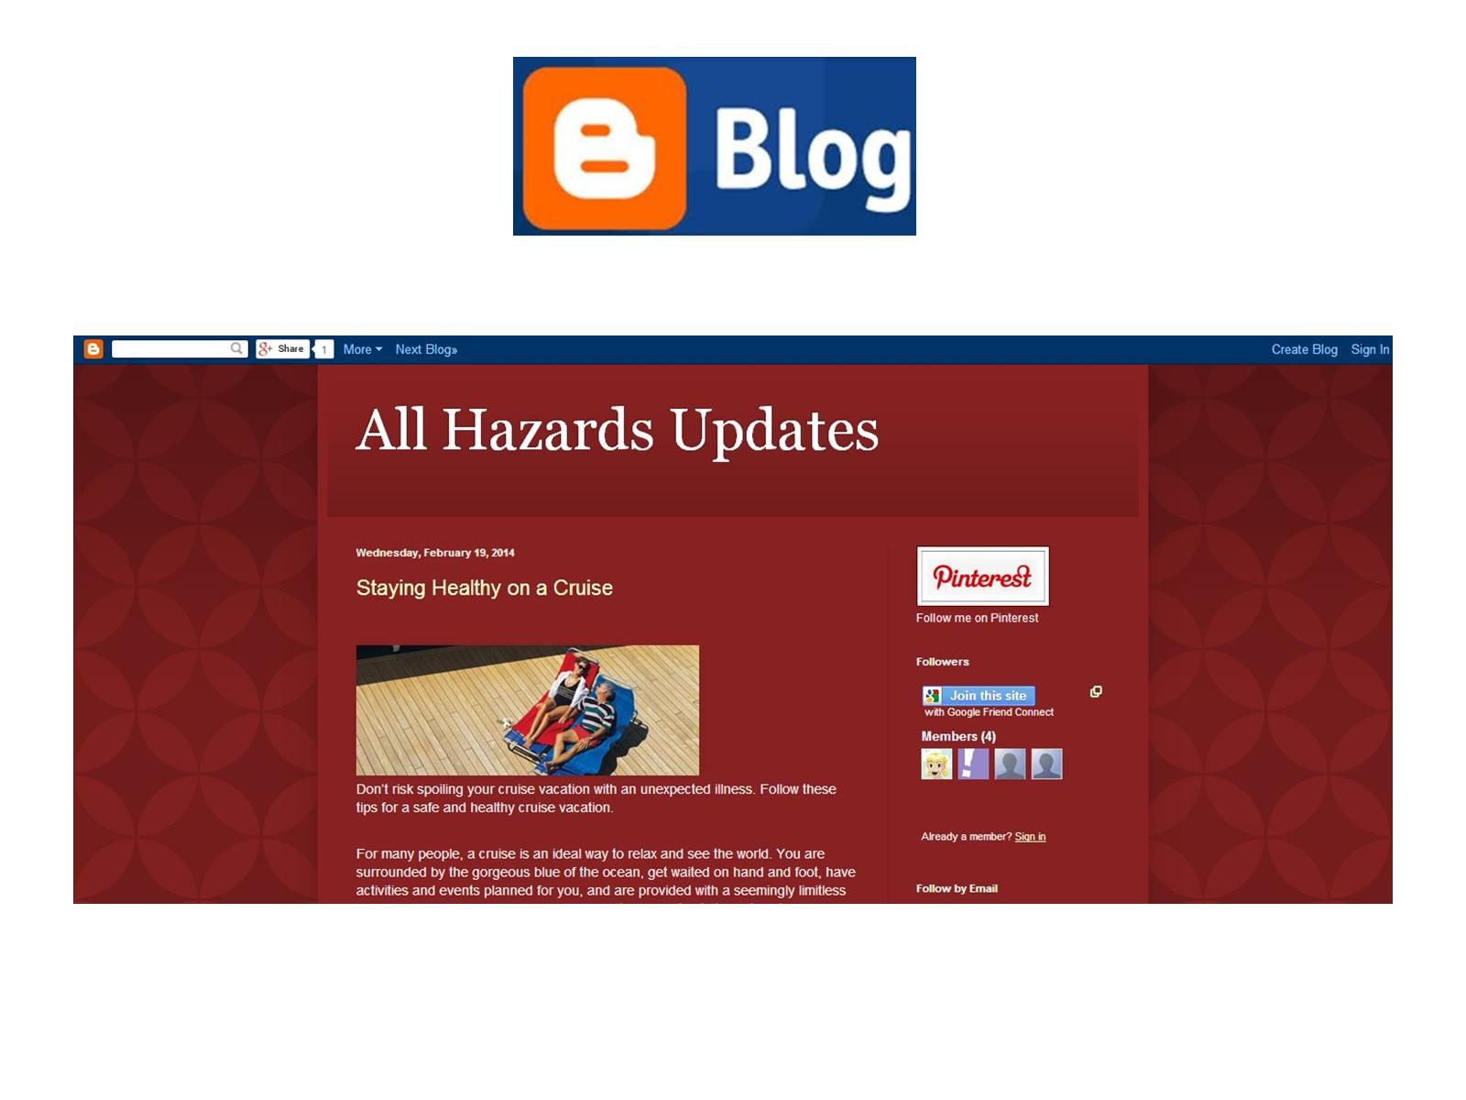

Slide 47
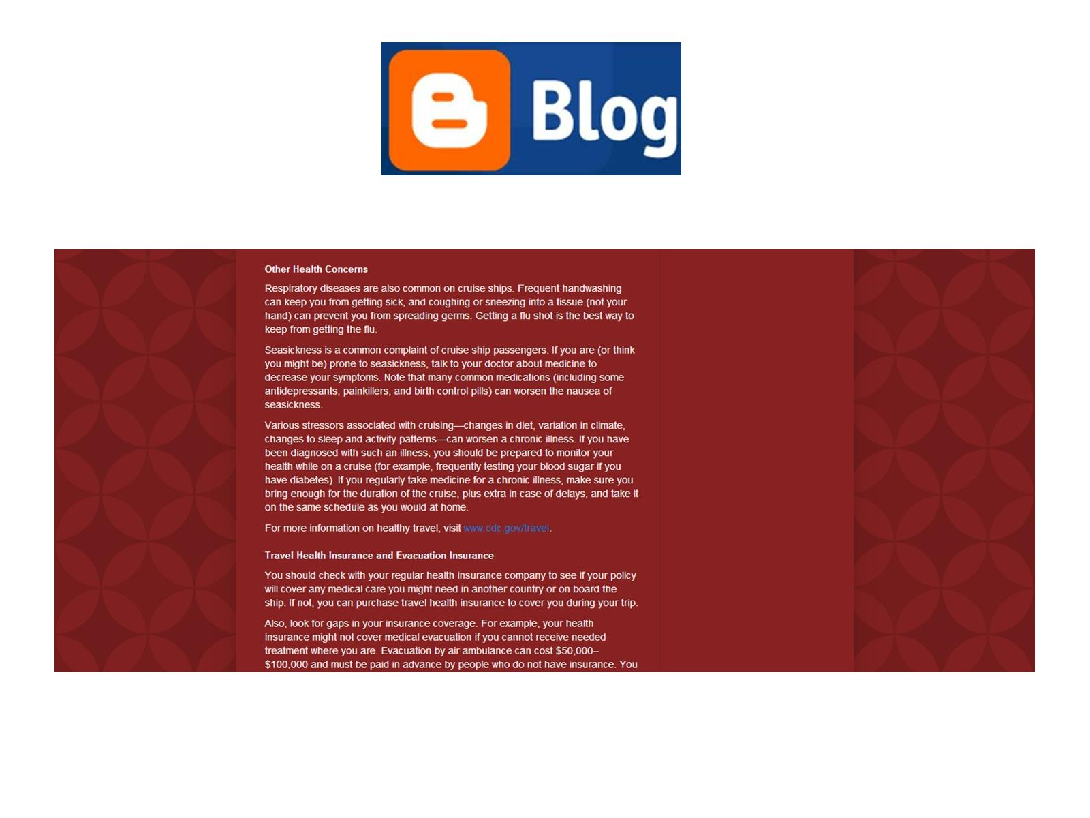

Slide 48
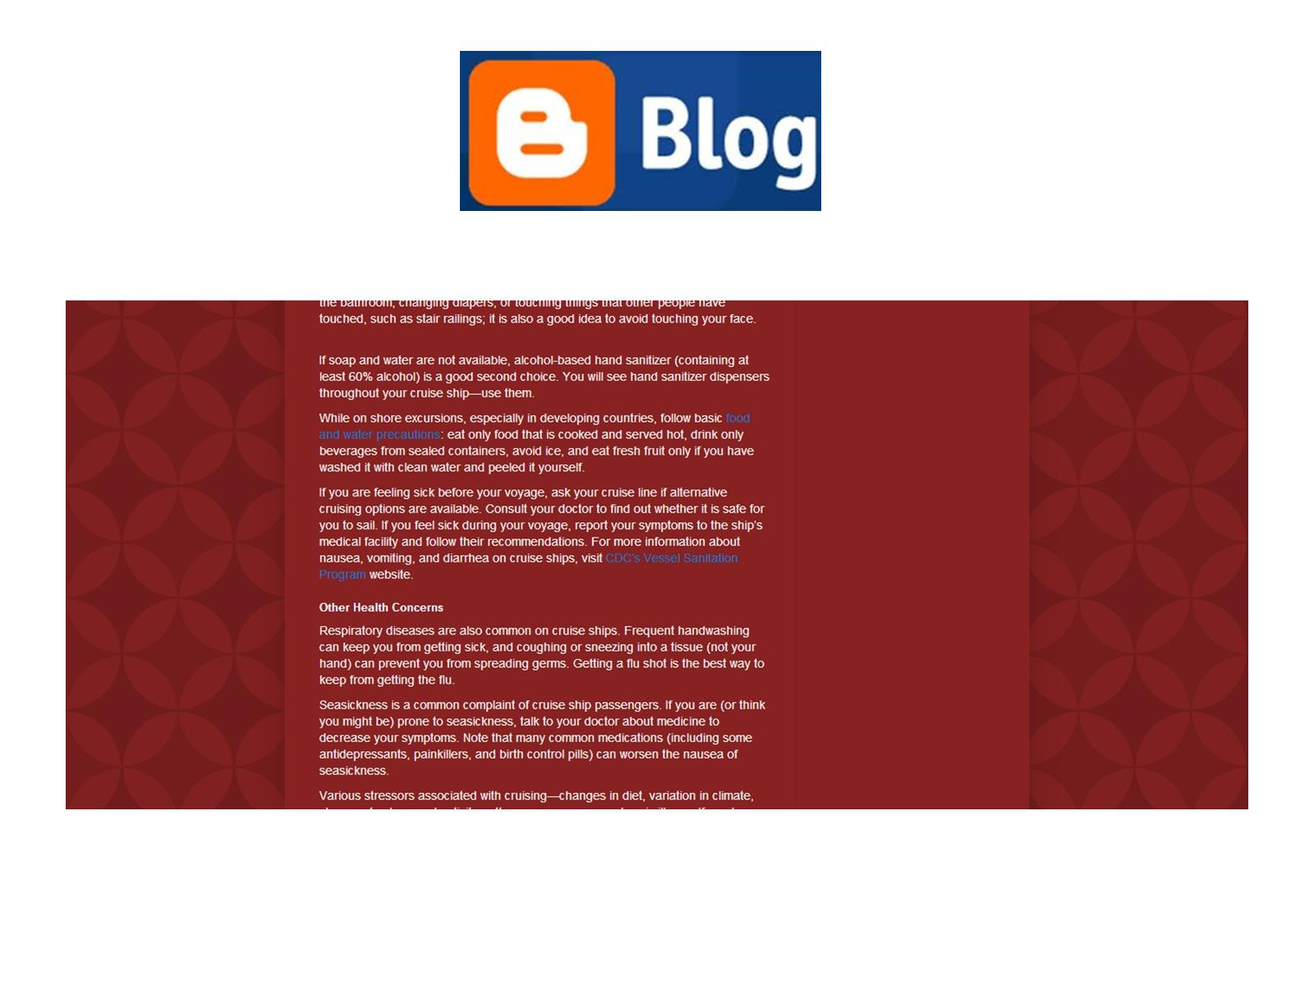

Slide 49
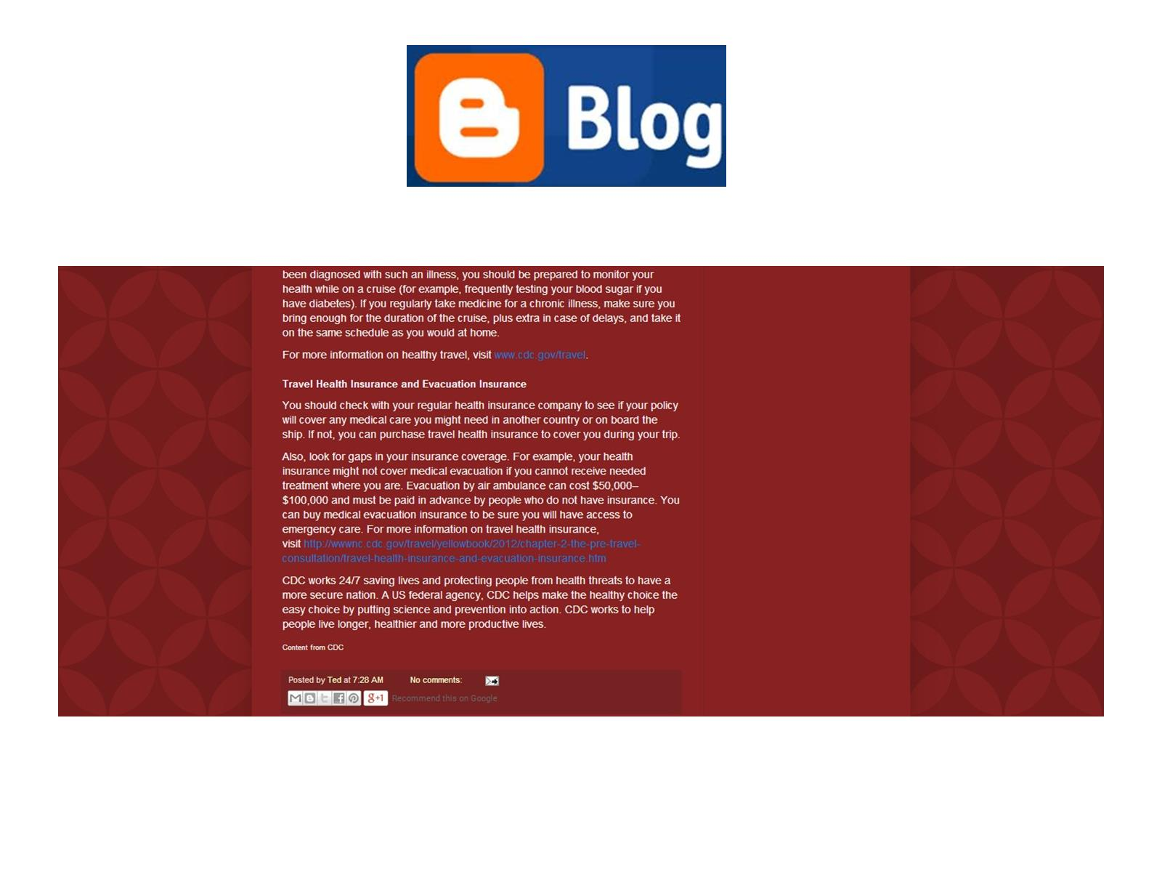

Slide 50
“The Clouds”

Slide 51
Evernote

Slide 52
Evernote

Slide 53
Postach.io

Slide 54
Evernote/Postach.io

Slide 55
Evernote/Postach.io

Slide 56
Social Media Management

Slide 57
Hootsuite Dashboard

Slide 58
Hootsuite Messaging

Slide 59
Hootsuite Scheduler

Slide 60
Hootsuite Publisher

Slide 61
Effective Social Media

Slide 62
Platform Synergy

Slide 63
Bare-Bones Scenario

Slide 64
Bare-Bones Scenario

Slide 65
Questions

Slide 66
Your Decision

Slide 67
Citation

Slide 68
http://www.cdc.gov/socialmedia/tools/guidelines/pdf/socialmediatoolkit_bm.pdf

Slide 69
Ted Krafczyk

