Slide 1
The Economic Impact of Anti-CGRPs

Slide 3
Contents

Slide 4
Migraine Is More Than a Headache¹

Slide 5
Migraine Impacts Individuals During the Formative and Most Productive Periods of Their Lives¹⁻³

Slide 6
The Annual Economic Burden of Migraine in the United States Was Estimated to Be $37.1 Billion¹⁻³

Slide 7
Study Design and Methodology

Slide 8
Important Considerations

Slide 9
Assumptions

Slide 10
Limitations

Slide 11
Annual Direct US Costs Associated With Migraine Were Estimated to Be ~ $11,000 per Patient¹

Slide 12
Annual Indirect US Costs Due to Absenteeism and Presenteeism Were Estimated to Be ~ $9,200 per Patient¹

Slide 13
Reducing Monthly Migraine Days (MMDs) With Anti-CGRP Treatment Resulted in Direct and Indirect Cost Offsets^{1,†}

Slide 14
Reducing Monthly Migraine Days (MMDs) With Aimovig® Resulted in Direct and Indirect Cost Offsets^{1,†}

Slide 15
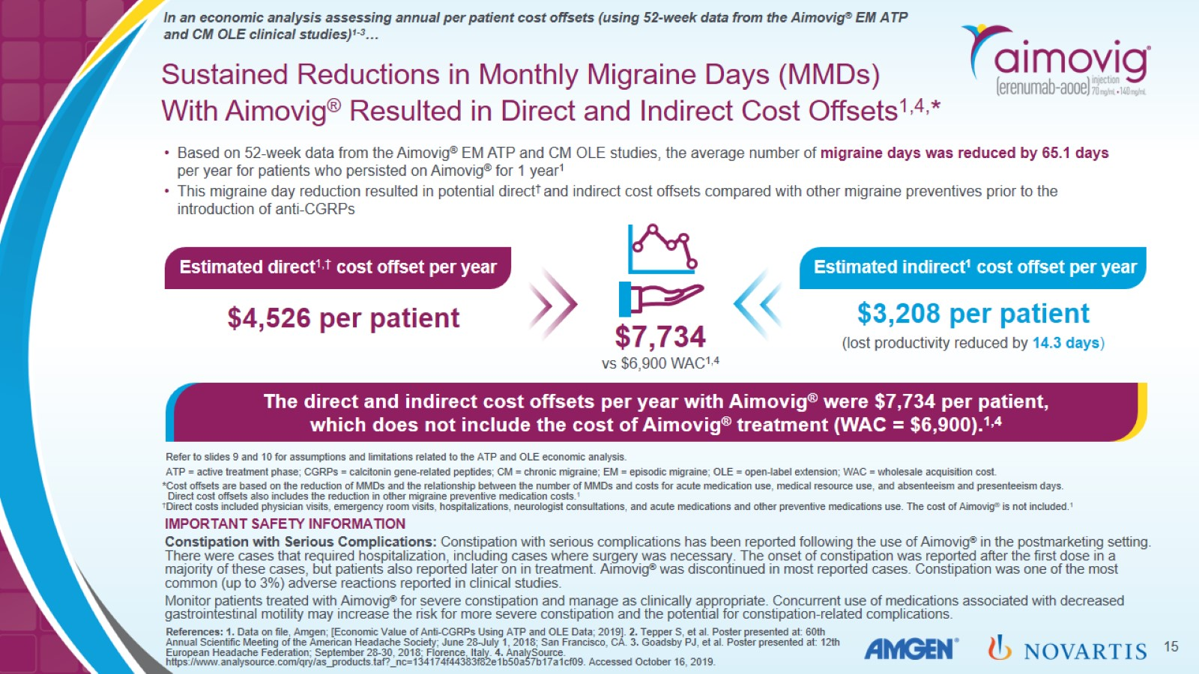
Sustained Reductions in Monthly Migraine Days (MMDs) With Aimovig® Resulted in Direct and Indirect Cost Offsets^{1,4,}*

Slide 16
Important Safety Information

Slide 17
Aimovig® Provides a Potential Economic Savings to Patients With Migraine^{1,2,*}

Slide 18
Network Meta-analysis

Slide 19
Financial Disclosures

Slide 20
Financial Disclosures

Slide 21
Summary of Characteristics of Anti-CGRP Medications Indicated for the Preventive Treatment of Migraine in Adults¹⁻³

